Slide 1
Chapter 12
Law

Slide 2
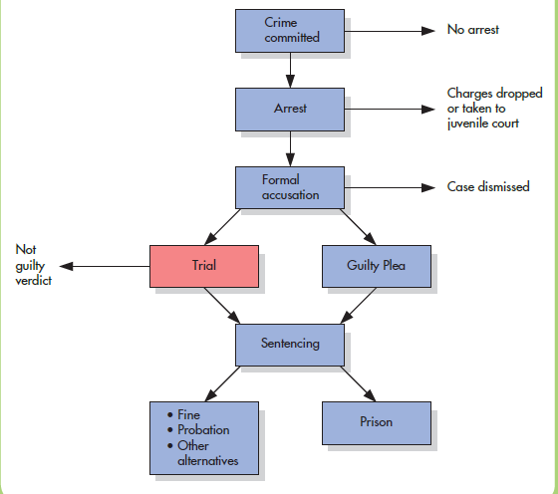
Overview of the American Criminal Justice System
Notes:
Figure 12.1 Overview of the American Criminal Justice System This flowchart presents the movement of cases through different branches of the criminal justice system. As illustrated here, the trial is just one aspect of the criminal justice system. Adapted from the President’s Commission on Law Enforcement and Administration of Justice, 1967.

Slide 3
Relationship between law and social psych?
Whether police can tell when someone is lying
How they can make these judgments more accurately
How cognitive biases interfere with the processes of investigation
How juries make decisions in civil lawsuits that involve large sums of money
Why people cooperate with authorities and obey the law

Slide 4
Eyewitness Testimony
How accurate are eyewitness accounts?
  Case: Jennifer Thompson and Ronald Cotton
Case Background: July 1984, an assailant broke into Jennifer Thompson’s apartment and sexually assaulted her; later that night they assaulted a second woman

Slide 5
Eyewitness Testimony
Jennifer memorized the face/characteristics of her assailant and positively ID’d Ronald Cotton
Cotton was eventually sentenced to life in prison
Problem: He was innocent

Slide 6
Eyewitness Testimony
How did it happen?
  Cotton and the assailant shared similar physical features
    Examples: Physical build, skin tone, mustache, etc.
  Cotton had previously been in trouble with the law
    Seemed “in character” for him
  Circumstantial evidence
    Owned a flashlight that was similar to the one the assailant was purported to use

Slide 7
Eyewitness Testimony
But the biggest reason:
  Thompson was 100% convinced it was Cotton
    Immediately identified him when looking at photographs
  Suggests that eyewitness memory isn’t perfect!

Slide 8
Eyewitness Testimony
Three conclusions about eyewitness testimony:
  Eyewitnesses are imperfect.
  Certain personal and situational factors can systematically influence their performance.
  Judges, juries, and lawyers are not adequately informed about these factors.

Slide 9
Perceiving the Crime
Physical conditions
Witness’s emotional and mental state
Weapon-focus effect
  The tendency for the presence of a weapon to draw attention and impair a witness’s ability to identify the culprit.
Cross-race identification bias
  The tendency for people to be more accurate at recognizing members of their own racial group than of other groups.

Slide 10
Storing Memory (1 of 2)
Refers to getting the information into memory to avoid forgetting
Memory for faces and events tends to decline with the passage of time.
  Not all recollections fade, and time alone does not cause memory slippage.
Reconstructive memory
  Is likely to have been exposed to so much postevent information that one wonders if their original memory is still “pure”

Slide 11
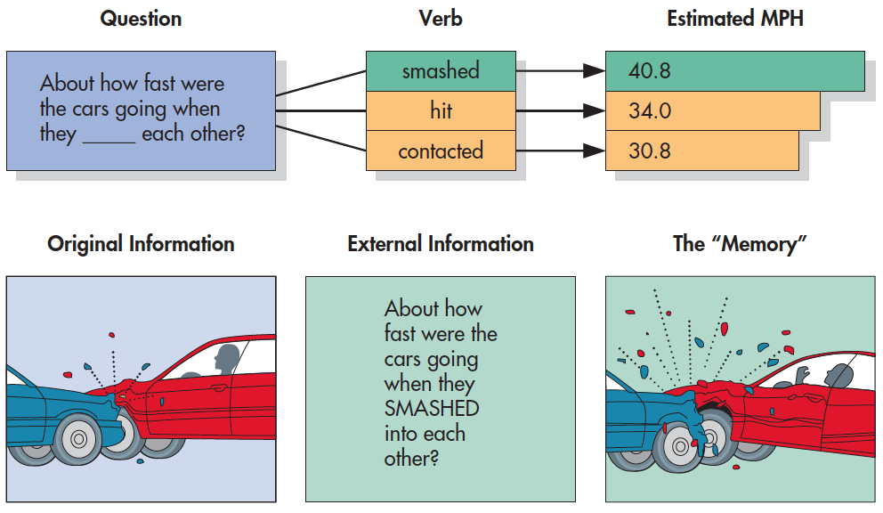
Biasing Eyewitness Reports with Loaded Questions (Loftus & Loftus, 1986)
Notes:
Figure 12.2 Biasing Eyewitness Reports with Loaded Questions Participants viewed a film of a traffic accident and then answered this question: “About how fast were these cars going when they (hit, smashed, or contacted) each other?” As shown, the wording of the question influenced speed estimates (top). One week later, it also caused participants to reconstruct their memory of other aspects of the accident (bottom). From Loftus & Loftus (1976).

Slide 12
Storing Memory (2 of 2)
Misinformation effect
  The tendency for false postevent misinformation to become integrated into people’s memory of an event.
  Witnesses who are not alert because they have been sleep-deprived are especially vulnerable.
Can children’s memories be similarly influenced?
  Repetition, misinformation, and leading questions can bias a child’s memory report, and preschoolers are particularly vulnerable.

Slide 13
Biasing Eyewitness Reports with Loaded Questions (Loftus & Loftus, 1986)
Phrasing like “smashed” vs “hit” or “crashed” == witnesses more likely to misremember broken glass, injuries to drivers, etc.
Notes:
Figure 12.2 Biasing Eyewitness Reports with Loaded Questions Participants viewed a film of a traffic accident and then answered this question: “About how fast were these cars going when they (hit, smashed, or contacted) each other?” As shown, the wording of the question influenced speed estimates (top). One week later, it also caused participants to reconstruct their memory of other aspects of the accident (bottom). From Loftus & Loftus (1976).

Slide 14
Identifying the Culprit
Before witnesses reach the courtroom, they are questioned by police and lawyers.
  Possibly even assist in creating a facial composite or an artist’s sketch of the perpetrator.
Factors affecting identification performance:
  Lineup construction
  Lineup instructions to the witness
  Familiarity-induced biases

Slide 15
Effects of Lineup and Instructions on False Identifications (Malpass & Devine (1969)
Culprit is in the line up (biased) or might be in the line up (unbiased). Percent false id’s?
Percentage of False Identifications
Unbiased Biased
Instructions Instructions
Culprit present 0 25
Culprit absent 33 78
Notes:
Table 12.1 Effects of Lineup and Instructions on False Identifications After witnessing a crime, participants were told either that the culprit was in the lineup (biased instruction) or that he might or might not be present (unbiased instruction). Participants then viewed a lineup in which the real culprit was present or absent. Notice the percentage of participants in each group who identified an innocent person. Those who received the biased instruction were more likely to make a false identification, picking an innocent person rather than no one at all, especially when the real culprit was not in the lineup.
From Malpass & Devine (1969).

Slide 16
Testifying in Court
Jurors often overestimate the accuracy of eyewitnesses but could not distinguish between witnesses whose identifications were correct and those whose identifications were incorrect.
  People do not know about many aspects of human perception.
  People tend to base their judgments of an eyewitness largely on how confident that witness is.

Slide 17
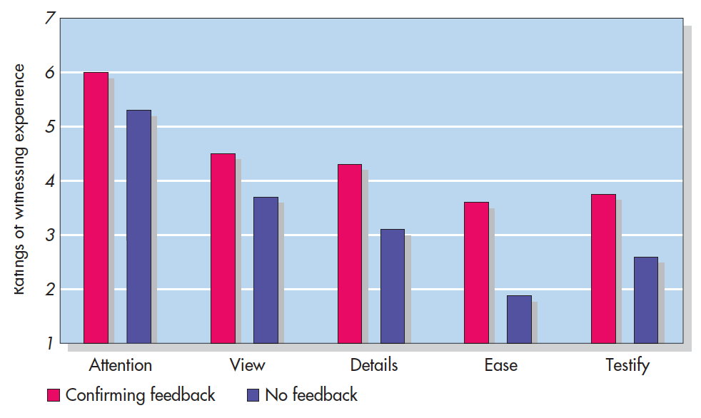
The Biasing Effects of Post-Identification Feedback (Wells & Bradfield, 1998)
Notes:
Figure 12.3 The Biasing Effects of Post-Identification Feedback Participants saw a gunman on videotape and then tried to make an identification from a set of photographs in which he was absent. Afterward, the experimenter gave some witnesses but not others confirming feedback about their selection. As shown, those given the confirming feedback later recalled that they had paid more attention to the event, had a better view of it, could make out details of the culprit’s face, and found it easier to make the identification. They were also more willing to testify in court. Wells & Bradfield, 1998

Slide 18
Improving Eyewitness Justice
Social psychologists are in a position to put their knowledge to use in two important ways:
  By educating judges and juries about the science so that they can better evaluate eyewitnesses who testify in court.
  By making eyewitness identification evidence itself more accurate.

Slide 19
Suspect Interviews: The Psychology of Lie Detection
Polygraph (“lie-detector test”) is an electronic instrument, commonly used by police, that simultaneously records multiple channels of physiological arousal.
Control question test
  Compare changes in arousal between neutral and “relevant” questions
  “Have you ever mistrusted someone?” vs. “did you shoot your wife?”

Slide 20
Suspect Interviews: The Psychology of Lie Detection
Truthful persons too often fail the test!
  The test can be beaten by artificially inflating the responses to “innocent” questions
  There is no evidence that any pattern of physiological reactions is unique to deception

Slide 21
False Confessions
People under police interrogation agree to confess as an act of mere compliance—to escape a very stressful situation.
Risk factors for false confessions
  A suspect who lacks a clear memory of the event in question
  The presentation of false evidence
The general interrogation process can induce false confessions

Slide 22
The Nine Steps of Interrogation (Inbau et al., 2001)
Confront the suspect with assertions of his or her guilt.
Develop “themes” that appear to justify or excuse the crime.
Interrupt all statements of innocence and denial.
Overcome all of the suspect’s objections to the charges.
Keep the increasingly passive suspect from tuning out.
Show sympathy and understanding and urge the suspect to tell all.
Offer the suspect a face-saving explanation for his or her guilty action.
Get the suspect to recount the details of the crime.
Convert that statement into a full written confession.
Notes:
Table 12.3 The Nine Steps of Interrogation Inbau et al., 2001

Slide 23
Do Guilty Expectations Produce False Confessions? (Narchet et al., 2011)
Participants solved a series of problems
  Half alone, half w/ confederate
  Half were induced to cheat (guilty), other half did not (innocent)
  Eight additional participants interrogated participants to determine if they cheated (guilty expectations vs innocence expectations)
  Did interrogators expectations affect participants’ confessions?
Notes:
Figure 12.5 Interrogation as a Self-Fulfilling Prophecy: Do Guilty Expectations Produce False Confessions? Participants were asked to solve a series of problems, sometimes alone and sometimes with a confederate. Half were induced to cheat on the alone task, making them guilty of violating the rule; the other half were not induced to cheat, making them innocent. Eight young men then interrogated participants to determine if they had cheated. In some cases, the interrogators were led to believe the participant was probably guilty; in other cases, that he or she was probably innocent. As shown, interrogators produced confessions from most participants who had cheated. Armed with guilty expectations, however, they also produced a high rate of false confessions from participants who were innocent. Narchet et al., 2011

Slide 24
Do Guilty Expectations Produce False Confessions? (Narchet et al., 2011)
Notes:
Figure 12.5 Interrogation as a Self-Fulfilling Prophecy: Do Guilty Expectations Produce False Confessions? Participants were asked to solve a series of problems, sometimes alone and sometimes with a confederate. Half were induced to cheat on the alone task, making them guilty of violating the rule; the other half were not induced to cheat, making them innocent. Eight young men then interrogated participants to determine if they had cheated. In some cases, the interrogators were led to believe the participant was probably guilty; in other cases, that he or she was probably innocent. As shown, interrogators produced confessions from most participants who had cheated. Armed with guilty expectations, however, they also produced a high rate of false confessions from participants who were innocent. Narchet et al., 2011

Slide 25
Confessions in the Courtroom
Juries are so strongly influenced by a confession, even if they believe it was coerced.
  Leads us to trust people who make statements against their own self-interest
  Confessions contain a great deal of detail.
  Confession evidence is so persuasive that it can corrupt other evidence.

Slide 26
Jury Selection
Random selection of eligible citizens from the jury pool
  A pretrial interview in which the judge and lawyers question the prospective jurors for signs of bias.
Peremptory challenge
  A means by which lawyers can exclude a limited number of prospective jurors without the judge’s approval.

Slide 27
The Courtroom Trial
Procedure
  Lawyers for both sides make opening statements.
  Witnesses then answer questions under oath.
  Lawyers make closing arguments.
  The judge instructs the jury.

Slide 28
Jury Deliberation
Is the belief in the wisdom of the group (juries) justified?

Slide 29
The Dynamics of Deliberation
Three-step process to decisions:
  i. Orientation
  ii. Open conflict
  iii. Reconciliation
“Majority rules” versus leniency bias
  In criminal trials, deliberation tends to produce a leniency bias that favors the defendant.
How do juries resolve disagreements?
  Conformity studies revisited

Slide 30
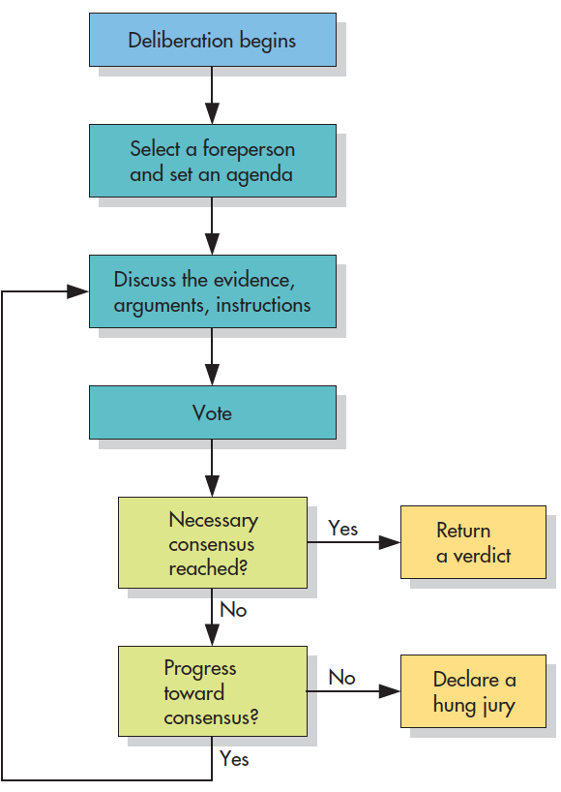
Jury Deliberations: The Process
Notes:
Figure 12.8 Jury Deliberations: The Process Juries move through various tasks en route to a verdict. They begin by setting and reviewing the case. If all jurors agree, they return a verdict. If not, they continue to discuss the case until they reach a consensus. If the holdouts refuse to vote with the majority, the jury becomes deadlocked.

Slide 31
The Road to Agreement: From Individual Votes to a Group Verdict
Initial Votes
(Guilty-Not Guilty) Final Jury Verdicts (%)
Conviction Acquittal Hung
6-0 100 0 0
5-1 78 7 16
4-2 44 26 30
3-3 9 51 40
2-4 4 79 17
1-5 0 93 7
0-6 0 100 0
Notes:
Table 12.5 The Road to Agreement: From Individual Votes to a Group Verdict Research has shown how verdicts are reached by mock juries that begin with different combinations of initial votes. You can see that the results support the majority-wins rule. But also note the evidence for a leniency bias: When the initial vote is split, juries gravitate toward acquittal (Kerr, 1981, as cited in Stasser et al., 1982).

Slide 32
Jury Size
How does jury size affect the decision-making process?
  Possible lack of allies in smaller juries may make it harder to resist normative pressures.
  Smaller juries are less likely to represent minority segments of the population.
  More likely to reach a unanimous verdict and to do so while deliberating for shorter periods of time

Slide 33
The Sentencing Process
Sentencing disparity
  Inconsistency of sentences for the same offense from one judge to another.
Disagreement about goals of imprisonment
  Incapacitate offenders and deter them from committing future crimes
  To exact retribution, or revenge, against the offender misdeeds

